Slide 1


SOCIAL BUZZ DATA ANALYSIS

Slide 2


Today's agenda
Project recap
Problem
The Analytics team
Process
Insights
Summary

Slide 3

Social Buzz is a new platform that keeps the user anonymous and has multiple ways to react with the post.
This has led Social Buzz to acquire out service to handle their big data.
We are also given the responsibility for their smooth transition from a private to a public entity.
They need an audit from our company for their big data to find out the best company to handle it.
We have to analyse certain deliverables that they have asked for
Project Recap

Slide 4


Problem
Social Buzz is a small company that has grown big in a very short amount of time this has led to them growing a lot of Big Data for which they need a middle company that can help analyse this data for them.
Not only this as they are growing they hace decided to scale their company from a private entity to a public entity. We are given the job to look after the smooth transition of their IPO
We are also taking care of the data cleaning and presenting analysis report on the various deliverables that Social Buzz has asked us to so they can make business decisions according to the need of their company.

Slide 5



The Analytics team
ANDREW FLEMING IS THE CHIEF TECHNICAL ARCHITECT
MARCUS ROMPTON IS THE SENIOR PRINCIPLE
SANKUL PANDEY MAIN DATA ANALYST

Slide 6
Process
1
We were given data in the form of Datasets. There were 7 Datasets in total with multiple columns. We had to choose the datasets which had the columns that were relevant to our analysis.
We after working through these 7 datasets finally found 3 Datasets that were actually relevant to our analysis, Remaining datasets were dropped and only those 3 datasets were considered and kept on for further analysis.
2
3
These 3 datasets were individually cleaned. Empty datasets were dropped, duplicate datasets were deleted and data was thoroughly cleaned and then merged into one true dataset using the Vlookup function
4
We then made further analysis on the new dataset and were asked to give them 5 top categories, We did this task by using the score column and then using the SUMIF function. We then get the required deliverables and our data is finally ready for visual representation.
5
We then completed visual analysis using Tableau and Excel. these two tools provide simple and easy to understand analysis that are best for the stakeholders to understand.

Slide 7

Insights
Top 5 categories comprise of Animals , healthy eating , science , technology and food wherein ‘Animals’ category takes up the top position with around 74945 reactions.
There are around 16 unique categories
Animals category has also gotten the most amount of reactions with around 1897 reactions in the animals column.

Slide 8
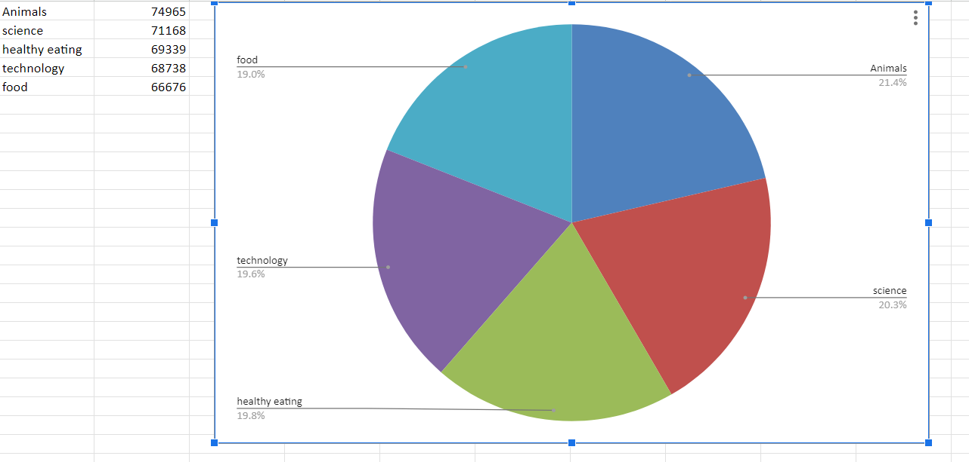
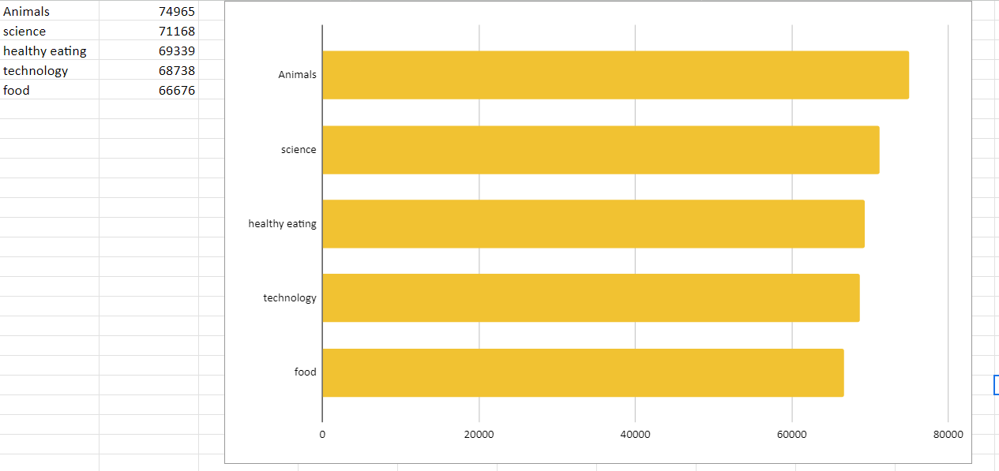

Slide 9
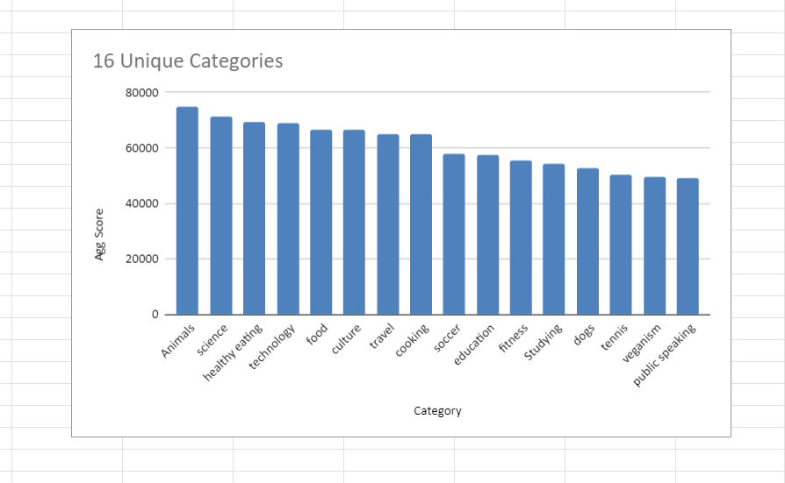
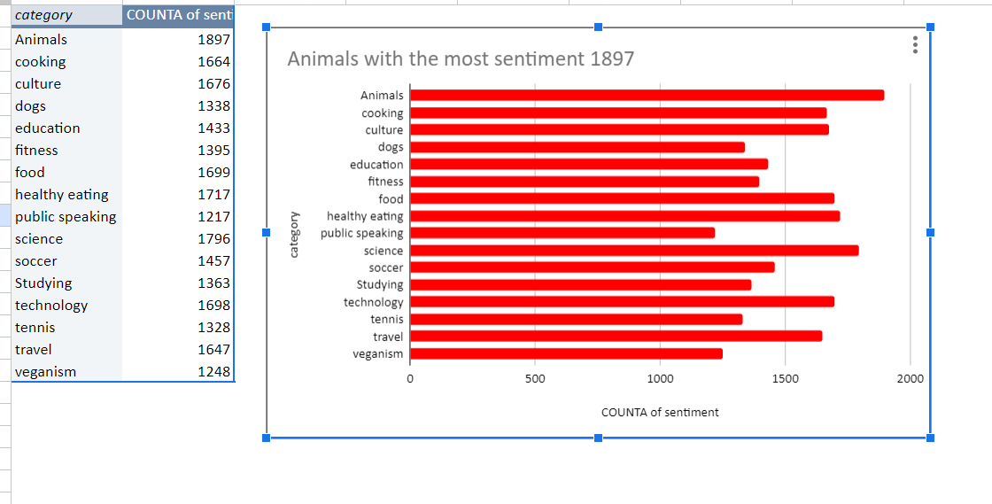

Slide 10

The dataset was a complex one to analyze because of all the problems it put forward but after cleaning the dataset it became very intriguing to analyze this particular dataset. The findings from this particular dataset will just enlighten us more regarding the type of data Social Buzz has on offer. This particular analysis will just enhance our ways to help the company in their pursuit of an easy transition of to IPO and also future projects related to the big data the company has on offer.
Summary

Slide 11

Thank you!
ANY QUESTIONS?

